Slide 1
CSE 4101: Project Management
Topic: Project Estimation with WBS Method

Slide 2
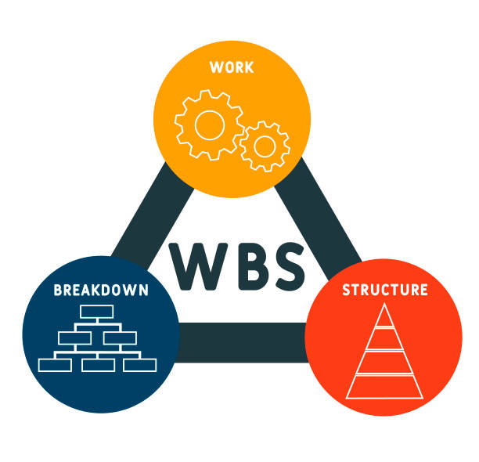
Today’s Agenda
01
Work Breakdown Structure (WBS)

Slide 3
What is Work Breakdown Structure (WBS)?
A work breakdown structure (WBS) is an outcome-oriented analysis of the work involved in a project that defines the total scope of the project.

Slide 4
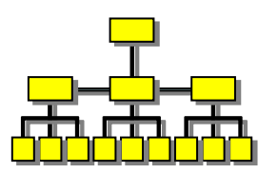
What is Work Breakdown Structure (WBS)?
Work Breakdown Structure (WBS) provides a notation for representing task structure:
Activities are represented as nodes of a tree.
The root of the tree is labelled by main task
Each task can be broken down into subtasks

Slide 5
Work Breakdown Structure Design Principles
1. Hierarchy
2. 100% rule
Each Work Breakdown Structure is hierarchical. That means every “child” on the graph has a hierarchical relationship with its parent task. When you add up all the “child” elements, it’ll give you a clear picture of the parent task.
While every Work Breakdown Structure is a little different, they all follow the 100% rule. Every level of the graph must make up 100% of the parent level, and it must have at least two “child” elements.
3. Mutually exclusive elements
4. Outcome-oriented
Every element at each level of a WBS template has to be mutually exclusive. That means there can’t be any overlap between deliverables or work. Enforcing mutual exclusivity helps cut down on miscommunication and avoid duplicate work.
WBS is fundamentally a deliverable-oriented system. That means your graphic depiction must focus on the outcomes rather than the activities required to produce them. A good rule of thumb is to describe elements using nouns rather than verbs.

Slide 6
6 tips for making a work breakdown structure
1. The 100% rule
2. Mutually exclusive
The work represented by your WBS must include 100% of the work necessary to complete the overarching goal without including any extraneous or unrelated work. Also, child tasks on any level must account for all of the work necessary to complete the parent task.
Do not include a sub-task twice or account for any amount of work twice. Doing so would violate the 100% rule and will result in miscalculations as you try to determine the resources necessary to complete a project.

Slide 7
6 tips for making a work breakdown structure
3. Outcomes, not actions
4. The 8/80 rule
Remember to focus on deliverables and outcomes rather than actions. For example, if you were building a bike, a deliverable might be “the braking system” while actions would include “calibrate the brake pads.”
There are several ways to decide when a work package is small enough without being too small. This rule is one of the most common suggestions—a work package should take no less than eight hours of effort, but no more than 80. Other rules suggest no more than ten days (which is the same as 80 hours if you work full time) or no more than a standard reporting period. In other words, if you report on your work every month, a work package should take no more than a month to complete.

Slide 8
6 tips for making a work breakdown structure
5. Three levels, Level 2 most important
6. Make assignments
Generally speaking, a WBS should include about three levels of detail. Some branches of the WBS will be more subdivided than others, but if most branches have about three levels, the scope of your project and the level of detail in your WBS are about right.
Every work package should be assigned to a specific team or individual. If you have made your WBS well, there will be no work overlap so responsibilities will be clear.

Slide 9
Other than Deliverables Oriented Other WBSs:
Verb-oriented WBS: A task-oriented WBS defines the deliverable of project work in terms of the actions that must be done to produce the deliverable. The first word in a given WBS element usually is a verb, such as, design, develop, optimize, transfer, test, etc.
Noun-oriented WBS: a deliverable-oriented WBS defines project work in terms of the components (physical or functional) that make up the deliverable.
Time-phased WBS: a “time-phased” WBS is one that is used on very long projects. It breaks the project into major phases instead of tasks.

Slide 10
Approaches to Developing WBSs
Using guidelines: Some organizations, like the DOD, provide guidelines for preparing WBSs
The analogy approach: It often helps to review WBSs of similar projects
The top-down approach: Start with the largest items of the project and keep breaking them down
The bottoms-up approach: Start with the detailed tasks and roll them up

Slide 11
Bottom-up versus Top-down
Bottom-up
Top-down
use when no past project data
identify all tasks that have to be done – so quite time-consuming
use when you have no data about similar past projects
produce overall estimate based on project cost drivers
based on past project data
divide overall estimate between jobs to be done

Slide 12
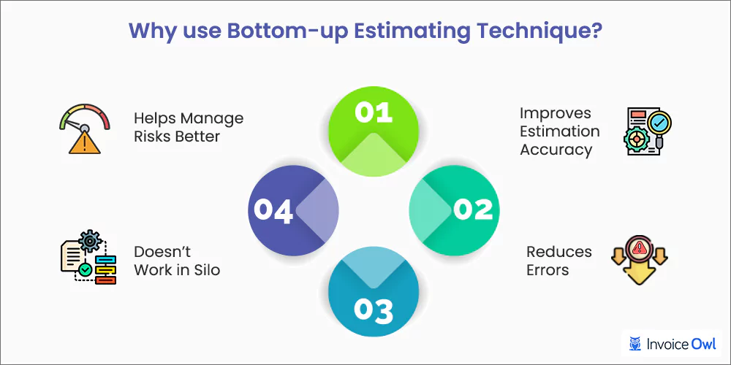
Bottom-up Estimating
1. Break project into smaller and smaller components
2. Stop when you get to what one person can do in one/two weeks
3. Estimate costs for the lowest level activities
4. At each higher level calculate estimate by adding estimates for lower levels

Slide 13
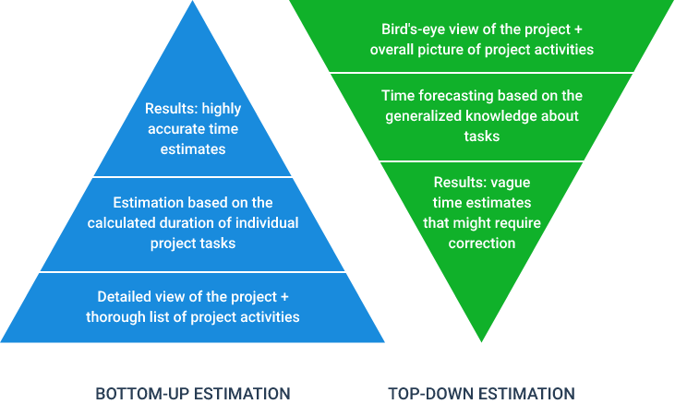
Top-down Estimating
Produce overall estimate using effort driver (s)
distribute proportions of overall estimate to components

Slide 14
Pros and Cons of WBS
Advantages
Disadvantages
More likely to obtain a task catalogue that is complete and is composed of non-overlapping tasks
WBS represents a structure that can be refined as the project proceeds
The structure already suggests the dependencies among the activities
Very likely to miss some activities if an unstructured activity list is used

Slide 15
Work breakdown structure formats
You can choose from several different format options when creating a work breakdown structure. The example above uses a tree format, which is the most visual option. It structures the WBS like an org chart and shows the hierarchy of tasks in addition to providing space for additional information about each work package.

Slide 16
WBS - Outline Structure
Build a House
1 Foundation
1.1 Excavate
1.1.1 Dig
1.1.2 Level
1.2 Frae
1.3 Concrete
1.3.1 Pour
1.3.2 Cure
2 Exterior
3 Interior
A text outline is the simplest WBS format. It is easy to put together and shows the hierarchy of tasks. However, it is difficult to add additional information about budget, duration, and assignment using this format.

Slide 17
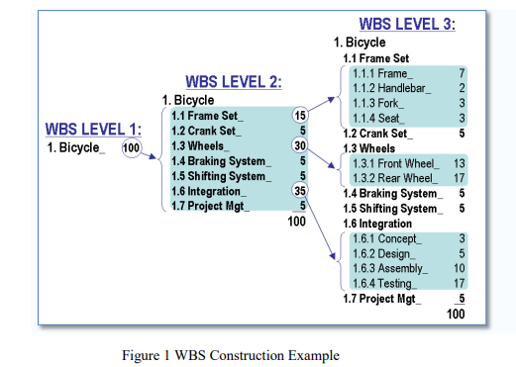
WBS - Level Structure

Slide 18
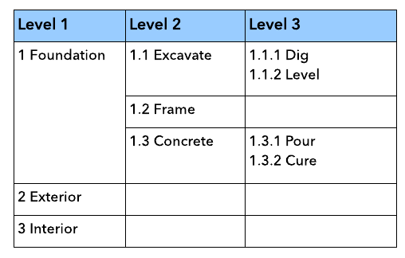
WBS - Tabular Structure
A tabular view is a more visually intuitive way to show hierarchy using a table.

Slide 19
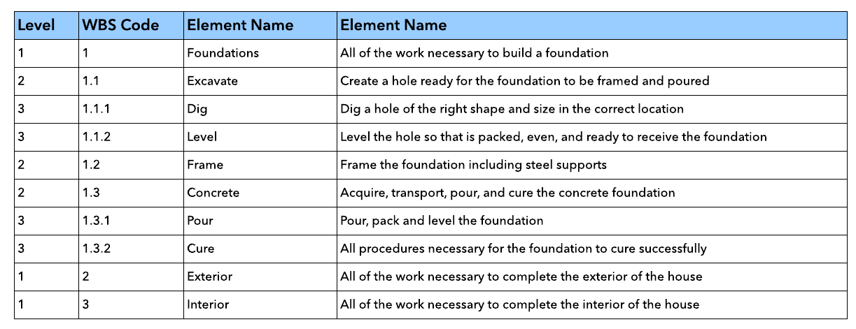
WBS - Dictionary Structure
What is a WBS dictionary? A WBS dictionary is formatted like the hierarchical structure, but it includes a brief description of each work package. When documenting a project, a WBS dictionary is often included in addition to a visualization of the WBS. It helps to clarify the scope of each task so that all team members understand their responsibilities.

Slide 20
WBS - Dictionary Structure
What is a WBS dictionary? A WBS dictionary is formatted like the hierarchical structure, but it includes a brief description of each work package. When documenting a project, a WBS dictionary is often included in addition to a visualization of the WBS. It helps to clarify the scope of each task so that all team members understand their responsibilities.

Slide 21
Other Topics:
WBS Pitfalls
WBS Checklist

Slide 22
Thank You

